Slide 1
Association Mining
What is Apriori Algorithm?
How Apriori Works
Association Mining Practice

Slide 2
What is Apriori Algorithm?

Slide 3
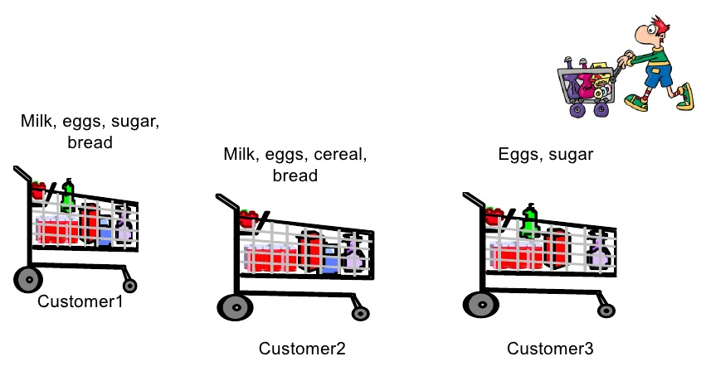
What is Apriori Algorithm?
Ideas come from the market basket analysis
Shopping example
Questions
Given a list of products, can we predict what a customer will buy next?
Goal
Find associations between different items that customers place in their basket
Notes:
아이디어는 장바구니 분석에서 나옵니다.

Slide 4
What is Apriori Algorithm?
Association rules
Itemset
Groups of one or more items that appears in the data with some regularity
{bread, peanut butter, jelly}
Association rules
If/then statements that help uncover associations between unrelated data in a dataset
{peanut butter, jelly} -> {bread}
Specify patterns found in the relationships/associations among items in the itemsets
Notes:
Itemset
어느 정도 규칙적으로 데이터에 나타나는 하나 이상의 항목 그룹
Association rules
데이터 세트에서 관련 없는 데이터 간의 연관성을 찾는 데 도움이 되는 If/then 문
항목 집합의 항목 간 관계/연관에서 발견된 패턴을 지정합니다.

Slide 5
What is Apriori Algorithm?
Applications
Searching for interesting and frequently occurring patterns of DNA and protein sequences in cancer data.
Finding patterns of purchases or medical claims that occur in combination with fraudulent credit card or insurance use.
Identifying combinations of behavior that precede customers dropping their cellular phone service or upgrading their cable television package.
Notes:
암 데이터에서 흥미롭고 자주 발생하는 DNA 및 단백질 서열 패턴을 검색합니다.
사기성 신용카드 또는 보험 사용과 결합하여 발생하는 구매 또는 의료 청구 패턴을 찾아냅니다.
고객이 휴대폰 서비스를 중단하거나 케이블 TV 패키지를 업그레이드하기 전에 나타나는 일련의 행동 조합을 식별합니다.

Slide 6

What is Apriori Algorithm?
Measuring rule interest – support and confidence
Association rules are determined by two statistical measures
Support
Measures how frequently the itemset occurs in the data
Confidence
Measurement of its predictive power or accuracy
Notes:
연관 규칙은 두 가지 통계적 척도에 의해 결정됩니다.
Support
데이터에서 항목 집합이 얼마나 자주 발생하는지 측정합니다.
Confidence
예측력 또는 정확성 측정

Slide 7
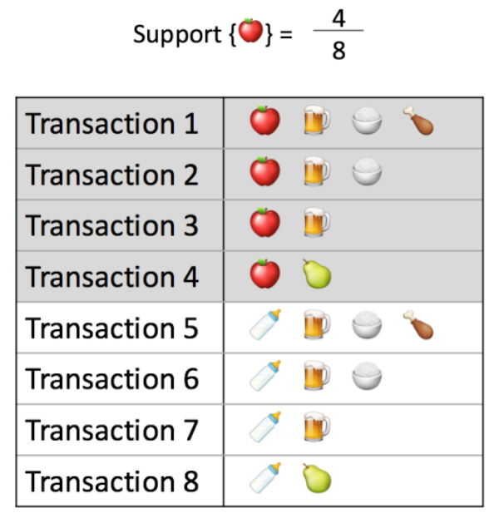
What is Apriori Algorithm?
Support
This says how popular item is in the dataset
Notes:
이는 데이터 세트에서 항목이 얼마나 인기 있는지를 나타냅니다.

Slide 8
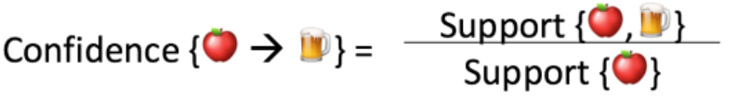
What is Apriori Algorithm?
Confidence
This says how likely the item Y is purchased when item X is purchased
= 3/4= 75%
Notes:
Confidence
이는 X 항목을 구매할 때 Y 항목을 구매할 확률을 나타냅니다.

Slide 9
How Apriori Works
B

Slide 10
How Apriori Works
Example
Given sample transactional data
Transactional data
Assume:
minsup = 40%
minconf = 70%
Transaction ID | Onion | Potato | Burger | Milk | Beer
T1 | 1 | 1 | 1 | 0 | 0
T2 | 0 | 1 | 1 | 1 | 0
T3 | 0 | 0 | 0 | 1 | 1
T4 | 1 | 1 | 0 | 1 | 0
T5 | 1 | 1 | 1 | 0 | 1
T6 | 1 | 1 | 1 | 1 | 0

Slide 11
How Apriori Works
Example
Step 1: Create a frequency table of all the items that occur in all transactions
Item | Frequency (No. of transactions)
Onion | 4
Potato | 5
Burger | 4
Milk | 4
Beer | 2
Support(Onion) = 4/6 = 66.6%
Support(Potato) = 5/6 = 83.3%
Support(Burger) = 4/6 = 66.6%
Support(Milk) = 4/6 = 66.6%
Support(Beer) = 2/6 = 33.3%
Notes:
Step 1: 모든 거래에서 발생하는 모든 항목의 빈도표를 만듭니다.

Slide 12
How Apriori Works
Example
Step 2: Determine elements for which the support is greater than or equal to the threshold support
1-Frequent Itemset
Item | Frequency (No. of transactions)
Onion | 4
Potato | 5
Burger | 4
Milk | 4
Beer | 2
Notes:
2단계: 지지도가 임계값 지지도보다 크거나 같은 요소 결정

Slide 13
How Apriori Works
Example
Step 3: The next step is to make all the possible pairs of the significant items keeping in mind that the order doesn’t matter
Itemset | Frequency (No. of transactions)
Onion, Potato | 4
Onion, Burger | 3
Onion, Milk | 2
Potato, Burger | 4
Potato, Milk | 3
Burger, Milk | 2
Notes:
3단계: 다음 단계는 순서가 중요하지 않다는 점을 염두에 두고 중요한 항목의 가능한 모든 쌍을 만드는 것입니다.

Slide 14
How Apriori Works
Example
Step 4: Remove the itemsets that has less support than minimum support
Itemset | Frequency (No. of transactions)
Onion, Potato | 4
Onion, Burger | 3
Onion, Milk | 2
Potato, Burger | 4
Potato, Milk | 3
Burger, Milk | 2
Support(Onion, Potato) = 4/6 = 66.6%
Support(Onion, Burger) = 3/6 = 50%
Support(Onion, Milk) = 2/6 = 33.3%
Support(Potato, Burger) = 4/6 = 66.6%
Support(Potato, Milk) = 3/6 = 50%
Support(Burger, Milk) = 2/6 = 33.3%
Notes:
4단계: 최소 지지도(40%)보다 낮은 지지도를 갖는 항목 집합 제거

Slide 15
How Apriori Works
Example
Step 4: Remove the itemsets that has less support than minimum support
2-Frequent Itemset
Itemset | Frequency (No. of transactions)
Onion, Potato | 4
Onion, Burger | 3
Potato, Burger | 4
Potato, Milk | 3
Notes:
최소 지지도보다 지지도가 낮은 항목 집합을 제거합니다.

Slide 16
How Apriori Works
Example
Step 5: Now let’s say we would like to look for a set of three items that are purchased together. We will use the itemsets found in step 4 and create a set of 3 items
3-Frequent Itemset
Itemset | Frequency (No. of transactions)
Onion, Potato, Burger | 3
Potato, Burger, Milk | 2
Support(Onion, Potato, Burger) = 3/6 = 50%
Support(Potato, Burger, Milk) = 2/6 = 33%
Notes:
이제 함께 구매한 세 가지 항목으로 구성된 세트를 찾고 싶다고 가정해 보겠습니다. 4단계에서 찾은 항목 세트를 사용하여 3개의 항목 세트를 만듭니다.

Slide 17
How Apriori Works
Example
Step 6: We can’t make any more frequent itemsets, so we stop here
1-Frequent Items
2-Frequent Items
Item | Frequency (No. of transactions)
Onion | 4
Potato | 5
Burger | 4
Milk | 4
Itemset | Frequency (No. of transactions)
Onion, Potato | 4
Onion, Burger | 3
Potato, Burger | 4
Potato, Milk | 3
3-Frequent Items
Itemset | Frequency (No. of transactions)
Onion, Potato, Burger | 3
Notes:
더 이상 빈번한 항목 집합을 만들 수 없으므로 여기에서 중지

Slide 18
How Apriori Works
Example
Step 7: Now we have our frequent itemset. From here we should create the association rules and calculate the confidence of each rules.
In this example let’s use the {Onion, Potato, Burger} as an example
Association rules
Onion, Potato => Burger | Onion => Potato, Burger
Onion, Burger => Potato | Burger => Onion, Potato
Burger, Potato => Onion | Potato => Onion, Burger
Itemset | Frequency (No. of transactions)
Onion, Potato, Burger | 3
Notes:
이제 우리는 빈번한 항목 집합을 갖게 되었습니다. 여기에서 연관 규칙을 생성하고 각 규칙의 신뢰도를 계산해야 합니다.
이 예에서는 {양파, 감자, 버거}를 예로 들어 보겠습니다.

Slide 19
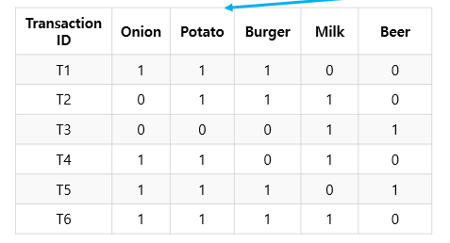
How Apriori Works
Example
Step 8: Calculate confidence score for all rules
Confidence(Onion, Potato => Burger) = 3/4 = 75%
Confidence(Onion, Burger => Potato) = 3/3 = 100%
Confidence(Burger, Potato => Onion) = 3/4 = 75%
Confidence(Onion => Potato, Burger) = 3/4 = 75%
Confidence(Burger => Onion, Potato) = 3/4 = 75%
Confidence(Potato => Onion, Burger) = 3/5 = 60%
Association rules
Onion, Potato => Burger
Onion, Burger => Potato
Burger, Potato => Onion
Onion => Potato, Burger
Burger => Onion, Potato
Potato => Onion, Burger
Notes:
모든 규칙에 대한 신뢰도 점수 계산

Slide 20
How Apriori Works
Example
The final association rules from the {Onion, Potato, Burger} will be shown in following table.
Association rules
Onion, Potato => Burger
Onion, Burger => Potato
Burger, Potato => Onion
Onion => Potato, Burger
Burger => Onion, Potato
Potato => Onion, Burger

Slide 21
How Apriori Works
Apriori algorithm in Python
pip install mlxtend
pip install pandas
import pandas as pd
from mlxtend.preprocessing import TransactionEncoder
from mlxtend.frequent_patterns import apriori
from mlxtend.frequent_patterns import association_rules
dataset = [['Onion', 'Potato', 'Burger'],
['Potato', 'Burger', 'Milk'],
['Milk', 'Beer'],
['Potato', 'Milk'],
['Onion', 'Potato', 'Burger', 'Beer'],
['Onion', 'Potato', 'Burger', 'Milk']
]

Slide 22
How Apriori Works
Apriori algorithm in Python
Transaction encoding
encode = TransactionEncoder()
encoded_array = encode.fit(dataset).transform(dataset)
encoded_array
array([[False, True, False, True, True],
[False, True, True, False, True],
[ True, False, True, False, False],
[False, False, True, False, True],
[ True, True, False, True, True],
[False, True, True, True, True]])

Slide 23
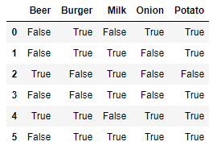
How Apriori Works
Apriori algorithm in Python
Transforming into data frame
dataframe = pd.DataFrame(encoded_array, columns=encode.columns_)
dataframe

Slide 24
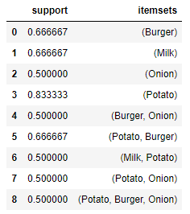
How Apriori Works
Apriori algorithm in Python
Train with Apriori algorithm (min_support = 0.4)
frequent_itemsets = apriori(dataframe, min_support=0.4, use_colnames=True)
frequent_itemsets
Notes:
Support
이는 데이터 세트에서 항목이 얼마나 인기 있는지를 나타냅니다.

Slide 25
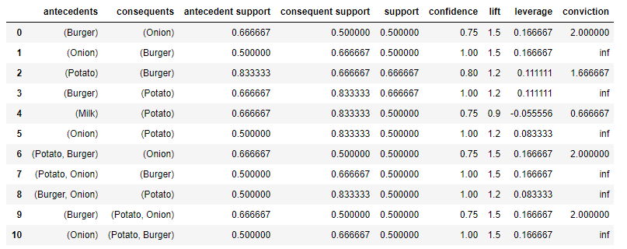
How Apriori Works
Apriori algorithm in Python
Creating association rules
pattern_rules = association_rules(frequent_itemsets, metric="confidence", min_threshold=0.7)
pattern_rules
Notes:
Confidence
이는 X 항목을 구매할 때 Y 항목을 구매할 확률을 나타냅니다.

Slide 26
Text Mining Practice
C

Slide 27
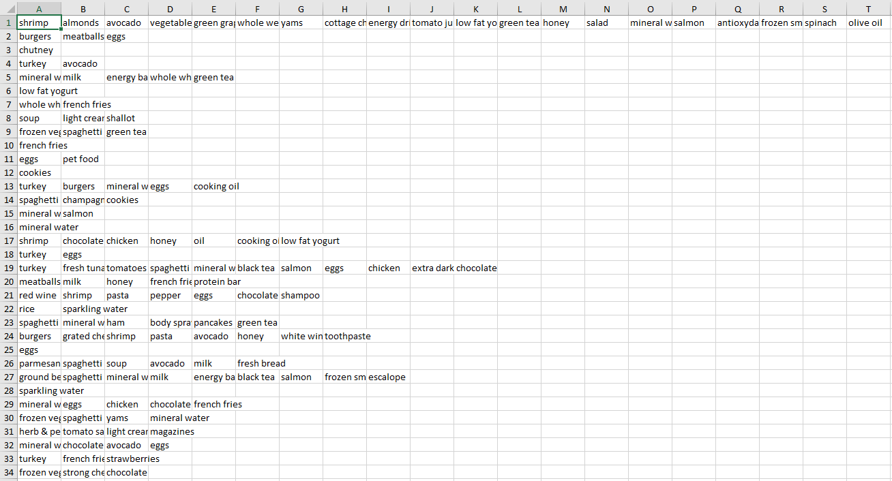
Text Mining Practice
Dataset
Market_Basket_Optimisation.csv

Slide 28
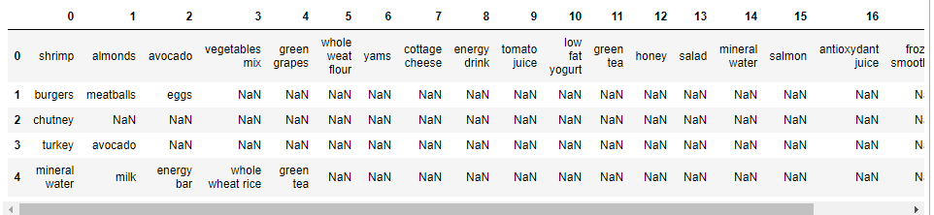
Text Mining Practice
Loading dataset
import pandas as pd
import seaborn as sns
import numpy as np
from pandas import DataFrame
import matplotlib.pyplot as plt
from mlxtend.preprocessing import TransactionEncoder
from mlxtend.frequent_patterns import apriori
from mlxtend.frequent_patterns import association_rules
basket = pd.read_csv("D:\Market_Basket_Optimisation.csv", header = None)
basket.head()

Slide 29
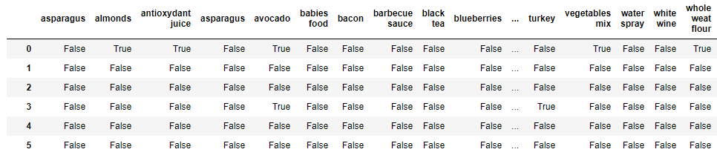
Text Mining Practice
Converting the data frame into a list of lists
Encoding and transforming back to data frame
records = []
for i in range (0, 7501):
records.append([str(basket.values[i,j]) for j in range(0, 20)])
encode = TransactionEncoder()
encoded_array = encode.fit(records).transform(records)
data_frame = pd.DataFrame(encoded_array, columns = encode.columns_)
data_frame

Slide 30
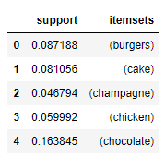
Text Mining Practice
Drop missing values
Train with Apriori
basket_clean = data_frame.drop(['nan'], axis = 1)
basket_clean
frequent_itemsets = apriori(basket_clean, min_support = 0.04, use_colnames = True)
frequent_itemsets.head()

Slide 31
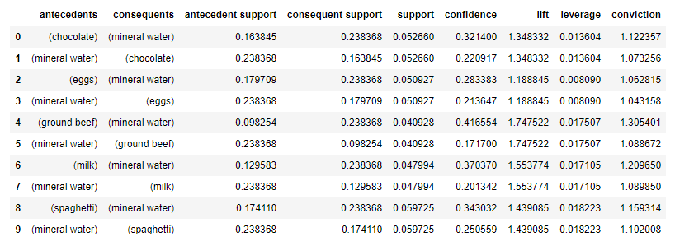
Text Mining Practice
Creating rules
pattern_rules = association_rules(frequent_itemsets, metric = confidence', min_threshold = 0.3)
pattern_rules

Slide 32
Quiz for Lecture 13
Submit your source code for the following task:
Try all source code in the lecture
Submission: source code, result explanation

